Slide 1
CSE214 – Analysis of Algorithms PhD Furkan Gözükara, Toros University https://github.com/FurkanGozukara/Analysis-of-Algorithms-2019
Lecture 9
Greedy Algorithms
Based on Cevdet David Matuszek’s Lecture Notes - Director of MCIT

Slide 2
Optimization problems
An optimization problem is one in which you want to find, not just a solution, but the best solution
A “greedy algorithm” sometimes works well for optimization problems
A greedy algorithm works in phases. At each phase:
You take the best you can get right now, without regard for future consequences
You hope that by choosing a local optimum at each step, you will end up at a global optimum
Notes:
2

Slide 3
Example: Counting money
Suppose you want to count out a certain amount of money, using the fewest possible bills and coins
A greedy algorithm would do this would be: At each step, take the largest possible bill or coin that does not overshoot
Example: To make $6.39, you can choose:
a $5 bill
a $1 bill, to make $6
a 25¢ coin, to make $6.25
A 10¢ coin, to make $6.35
four 1¢ coins, to make $6.39
For US money, the greedy algorithm always gives the optimum solution
Notes:
3

Slide 4
A failure of the greedy algorithm
In some (fictional) monetary system, “krons” come in 1 kron, 7 kron, and 10 kron coins
Using a greedy algorithm to count out 15 krons, you would get
A 10 kron piece
Five 1 kron pieces, for a total of 15 krons
This requires six coins
A better solution would be to use two 7 kron pieces and one 1 kron piece
This only requires three coins
The greedy algorithm results in a solution, but not in an optimal solution
Notes:
4

Slide 5
A scheduling problem
You have to run nine jobs, with running times of 3, 5, 6, 10, 11, 14, 15, 18, and 20 minutes
You have three processors on which you can run these jobs
You decide to do the longest-running jobs first, on whatever processor is available
P1
P2
P3
20
10
3
18
11
6
15
14
5
Time to completion: 18 + 11 + 6 = 35 minutes
This solution isn’t bad, but we might be able to do better
Notes:
5

Slide 6
Another approach
What would be the result if you ran the shortest job first?
Again, the running times are 3, 5, 6, 10, 11, 14, 15, 18, and 20 minutes
P1
P2
P3
3
10
15
5
11
18
6
14
20
That wasn’t such a good idea; time to completion is now 6 + 14 + 20 = 40 minutes
Note, however, that the greedy algorithm itself is fast
All we had to do at each stage was pick the minimum or maximum
Notes:
6

Slide 7
An optimum solution
Better solutions do exist:
P1
P2
P3
20
14
18
11
5
15
10
6
3
This solution is clearly optimal (why?)
Clearly, there are other optimal solutions (why?)
How do we find such a solution?
One way: Try all possible assignments of jobs to processors
Unfortunately, this approach can take exponential time
Notes:
7

Slide 8
Huffman Coding
Prepared by Dan Stevenson University of Wisconsin
Huffman codes can be used to compress information
Like WinZip – although WinZip doesn’t use the Huffman algorithm
JPEGs do use Huffman as part of their compression process
The basic idea is that instead of storing each character in a file as an 8-bit ASCII value, we will instead store the more frequently occurring characters using fewer bits and less frequently occurring characters using more bits
On average this should decrease the filesize (usually ½)

Slide 9
Huffman Coding
As an example, lets take the string:
“duke blue devils”
We first to a frequency count of the characters:
e:3, d:2, u:2, l:2, space:2, k:1, b:1, v:1, i:1, s:1
Next we use a Greedy algorithm to build up a Huffman Tree
We start with nodes for each character
e,3
d,2
u,2
l,2
sp,2
k,1
b,1
v,1
i,1
s,1

Slide 10
Huffman Coding
We then pick the nodes with the smallest frequency and combine them together to form a new node
The selection of these nodes is the Greedy part
The two selected nodes are removed from the set, but replace by the combined node
This continues until we have only 1 node left in the set

Slide 11
Huffman Coding
e,3
d,2
u,2
l,2
sp,2
k,1
b,1
v,1
i,1
s,1

Slide 12
Huffman Coding
e,3
d,2
u,2
l,2
sp,2
k,1
b,1
v,1
2
i,1
s,1

Slide 13
Huffman Coding
e,3
d,2
u,2
l,2
sp,2
k,1
2
2
b,1
v,1
i,1
s,1

Slide 14
Huffman Coding
e,3
d,2
u,2
l,2
sp,2
3
2
k,1
2
i,1
s,1
b,1
v,1

Slide 15
Huffman Coding
e,3
d,2
u,2
4
3
2
l,2
sp,2
k,1
2
i,1
s,1
b,1
v,1

Slide 16
Huffman Coding
e,3
4
4
3
2
d,2
u,2
l,2
sp,2
k,1
2
i,1
s,1
b,1
v,1

Slide 17
Huffman Coding
e,3
4
4
5
d,2
u,2
l,2
sp,2
2
3
i,1
s,1
k,1
2
b,1
v,1

Slide 18
Huffman Coding
7
4
5
e,3
4
l,2
sp,2
2
3
d,2
u,2
i,1
s,1
k,1
2
b,1
v,1

Slide 19
Huffman Coding
7
9
e,3
4
4
5
d,2
u,2
l,2
sp,2
2
3
i,1
s,1
k,1
2
b,1
v,1

Slide 20
Huffman Coding
16
7
9
e,3
4
4
5
d,2
u,2
l,2
sp,2
2
3
i,1
s,1
k,1
2
b,1
v,1

Slide 21
Huffman Coding
Now we assign codes to the tree by placing a 0 on every left branch and a 1 on every right branch
A traversal of the tree from root to leaf give the Huffman code for that particular leaf character
Note that no code is the prefix of another code

Slide 22
Huffman Coding
e | 00
d | 010
u | 011
l | 100
sp | 101
i | 1100
s | 1101
k | 1110
b | 11110
v | 11111
16
0
1
7
9
0
1
0
1
e,3
4
4
5
0
1
0
1
0
1
d,2
u,2
l,2
sp,2
2
3
0
1
0
1
i,1
s,1
k,1
2
0
1
b,1
v,1

Slide 23
Huffman Coding
These codes are then used to encode the string
Thus, “duke blue devils” turns into:
010 011 1110 00 101 11110 100 011 00 101 010 00 11111 1100 100 1101
When grouped into 8-bit bytes:
01001111 10001011 11101000 11001010 10001111 11100100 1101xxxx
Thus it takes 7 bytes of space compared to 16 characters * 1 byte/char = 16 bytes uncompressed

Slide 24
Huffman Coding
Uncompressing works by reading in the file bit by bit
Start at the root of the tree
If a 0 is read, head left
If a 1 is read, head right
When a leaf is reached decode that character and start over again at the root of the tree
Thus, we need to save Huffman table information as a header in the compressed file
Doesn’t add a significant amount of size to the file for large files (which are the ones you want to compress anyway)
Or we could use a fixed universal set of codes/frequencies

Slide 25
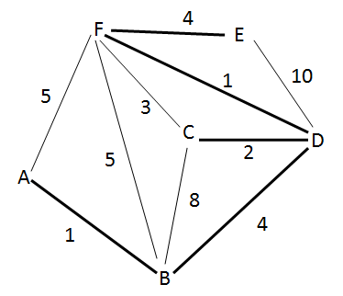
Minimum Spanning Tree
Prepared by Sarah Brubaker
Input: graph G with weights on the edges
Output: connected sub graph G’ of G that includes all the vertices of G, of minimum total weight

Slide 26
Exhaustive Search
List all connected sub-graphs of G
Return sub-graph with least weight
Number of vertices, N, and number of edges, M
O(m^{n-1})

Slide 27
Greedy Algorithm
Start with a graph containing just the vertices, G’={V,Ø}
Add edges with the least weight until the graph is connected but no cycles are created
To do this:
Order the edges in increasing weight
While the graph is not connected, add an edge
End when all vertices are connected

Slide 28
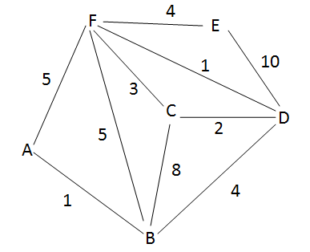
Greedy Algorithm - Example
List of Edges:
Initial Graph:
Edge | Weight
AB | 1
AF | 5
BC | 8
BD | 4
BF | 5
CD | 2
CF | 3
DE | 10
DF | 1
EF | 4

Slide 29
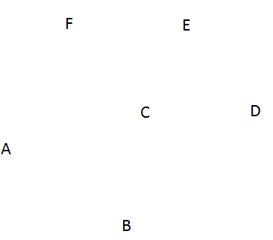
Greedy Algorithm - Example
Start with G’={V,Ø} and sorted list of edges
Sorted List of Edges:
Graph:
Edge | Weight
AB | 1
DF | 1
CD | 2
CF | 3
BD | 4
EF | 4
AF | 5
BF | 5
BC | 8
DE | 10

Slide 30
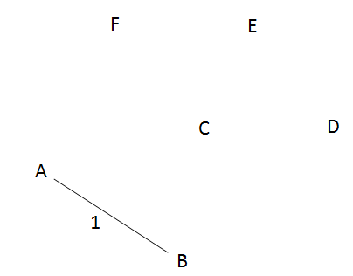
Greedy Algorithm - Example
Add edge from list to graph s.t. no cycles are created
Remove edge from list
Graph:
Sorted List of Edges:
Edge | Weight
AB | 1
DF | 1
CD | 2
CF | 3
BD | 4
EF | 4
AF | 5
BF | 5
BC | 8
DE | 10

Slide 31
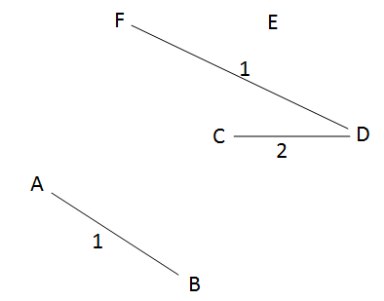
Greedy Algorithm - Example
Add edge from list to graph s.t. no cycles are created
Remove edge from list
Graph:
Sorted List of Edges:
Edge | Weight
AB | 1
DF | 1
CD | 2
CF | 3
BD | 4
EF | 4
AF | 5
BF | 5
BC | 8
DE | 10

Slide 32
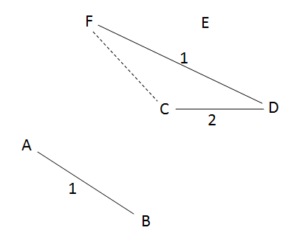
Greedy Algorithm - Example
Add edge from list to graph s.t. no cycles are created
Remove edge from list
Graph:
Sorted List of Edges:
Edge | Weight
CF | 3
BD | 4
EF | 4
AF | 5
BF | 5
BC | 8
DE | 10
Check for cycles using Depth First Search starting at a vertex in the added edge:
Start at C
C-> D -> F -> C
C gets visited twice => a cycle exists and CF should not be added to the graph

Slide 33
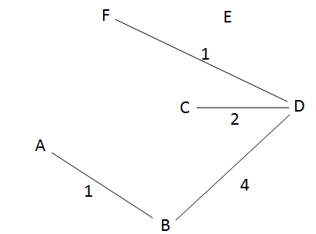
Greedy Algorithm - Example
Add edge from list to graph s.t. no cycles are created
Remove edge from list
End when all vertices can be visited (graph is connected)
Graph:
Sorted List of Edges:
Edge | Weight
BD | 4
EF | 4
AF | 5
BF | 5
BC | 8
DE | 10
Check for cycles using Depth First Search starting at a vertex in the added edge:
Start at B
B ->D ->C -> F -> A
If all vertices are visited by DFS, then the graph is connected and we are done

Slide 34
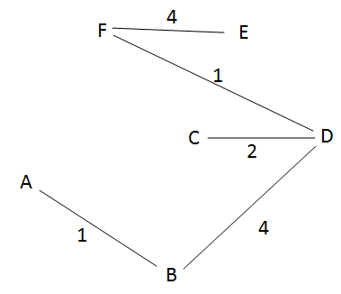
Greedy Algorithm - Example
Add edge from list to graph s.t. no cycles are created
Remove edge from list
End when all vertices can be visited (graph is connected)
Graph:
Sorted List of Edges:
Edge | Weight
EF | 4
AF | 5
BF | 5
BC | 8
DE | 10
Check for cycles using Depth First Search starting at a vertex in the added edge:
Start at E
E -> F -> D -> B -> A ->C
All vertices were visited and there were no cycles => we have found a minimum spanning tree with weight 12.

Slide 35
Greedy Algorithm- Pseudocode
Given G = (V, E)
G’ <- (V,Ø)
While G’ is not connected
Add e Є E to G’ s.t. G’ is acyclic and e is minimum
Remove e from E

Slide 36
Greedy Algorithm – Run Time
Initialization – constant
While loop – O(n-1)
Connected graph has n-1 edges
Must add n-1 edges to the graph for it to be connected
Find a minimum e ЄE – O(m)
Make sure G’ is acyclic – O(2n)
DFS is O(m+n)<O(2n) where m<=n-1
Test connectivity of G’ – O(n)
Can use DFS; could be done in same step as testing acyclicity
Remove e from E - constant
Total Runtime: O(n*(m+2n+n)) ~ O(nm+ n²) -> POLYNOMIAL

Slide 37
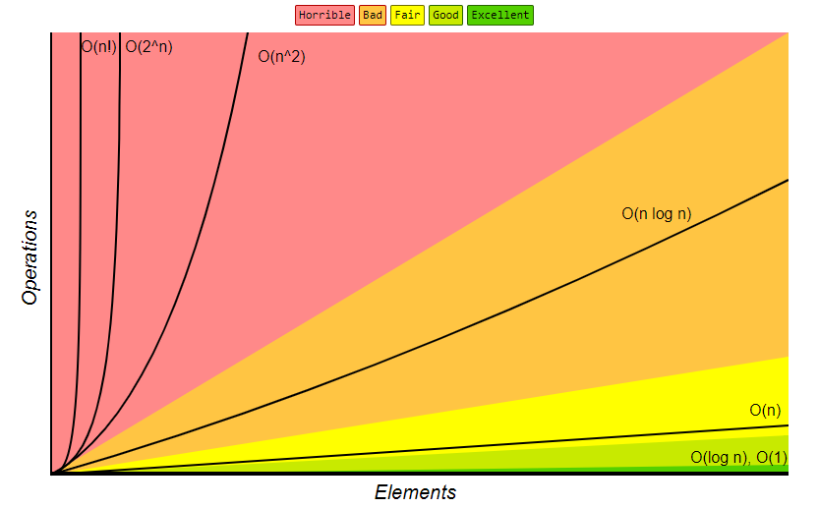

Slide 38
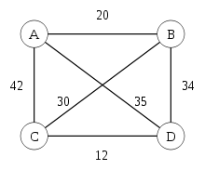
Traveling Salesman Problem (TSP)
Prepared by Caisar Oentoro
> The Problem is how to travel from city A and visit all city on the map, then back to city A again.
> The rules: you only visit each city once and you can’t pass through any traversed path.

Slide 39
Solution:
> Find the shortest path from city A(start) to any other city.
A
B
> Because the nearest city is B, so we go to B

Slide 40
> From B, we find any other city but A(because A has been visited) that has nearest path. So we choose C:
A
B
C

Slide 41
> From C, we look to nearest city again, but don’t look for A and B, because both has been visited. So we choose D.
A
B
C
D

Slide 42
> At this node(D), we can’t go to any city, because all neighbor of D has been visited. We go back to first city(A).
A
B
C
D
> And that was how to solve TSP problem.

Slide 43

Advantage of Greedy
> Greedy is easy to be implemented. Just search the best choice from the current state that ‘reachable’ (has any paths or any connections).
> In simple case, greedy often give you the best solution.

Slide 44
Drawback of Greedy
> In large and complex case, greedy doesn’t always give you the best solution, because it’s just search and take the best choice that you can reach from the current state.
> It takes longer time than any other algorithms for big case of problem

Slide 45
Analysis
A greedy algorithm typically makes (approximately) n choices for a problem of size n
(The first or last choice may be forced)
Hence the expected running time is: O(n * O(choice(n))), where choice(n) is making a choice among n objects
Counting: Must find largest useable coin from among k sizes of coin (k is a constant), an O(k)=O(1) operation;
Therefore, coin counting is (n)
Huffman: Must sort n values before making n choices
Therefore, Huffman is O(n log n) + O(n) = O(n log n)
Minimum spanning tree: At each new node, must include new edges and keep them sorted, which is O(n log n) overall
Therefore, MST is O(n log n) + O(n) = O(n log n)
Notes:
11

Slide 46
Other greedy algorithms
Dijkstra’s algorithm for finding the shortest path in a graph
Always takes the shortest edge connecting a known node to an unknown node
Kruskal’s algorithm for finding a minimum-cost spanning tree
Always tries the lowest-cost remaining edge
Prim’s algorithm for finding a minimum-cost spanning tree
Always takes the lowest-cost edge between nodes in the spanning tree and nodes not yet in the spanning tree

Slide 47
Dijkstra’s shortest-path algorithm
Dijkstra’s algorithm finds the shortest paths from a given node to all other nodes in a graph
Initially,
Mark the given node as known (path length is zero)
For each out-edge, set the distance in each neighboring node equal to the cost (length) of the out-edge, and set its predecessor to the initially given node
Repeatedly (until all nodes are known),
Find an unknown node containing the smallest distance
Mark the new node as known
For each node adjacent to the new node, examine its neighbors to see whether their estimated distance can be reduced (distance to known node plus cost of out-edge)
If so, also reset the predecessor of the new node

Slide 48
Example
Prepared by Jim Anderson
u
v
∞
1
∞
10
9
2
3
s
0
4
6
5
7
∞
∞
2
x
y

Slide 49
Example
u
v
10
1
∞
10
9
2
3
s
0
4
6
5
7
5
∞
2
x
y

Slide 50
Example
u
v
8
1
14
10
9
2
3
s
0
4
6
5
7
5
7
2
x
y

Slide 51
Example
u
v
8
1
13
10
9
2
3
s
0
4
6
5
7
5
7
2
x
y

Slide 52
Example
u
v
8
1
9
10
9
2
3
s
0
4
6
5
7
5
7
2
x
y

Slide 53
Example
u
v
8
1
9
10
9
2
3
s
0
4
6
5
7
5
7
2
x
y

Slide 54
Analysis of Dijkstra’s algorithm I
Assume that the average out-degree of a node is some constant k
Initially,
Mark the given node as known (path length is zero)
This takes O(1) (constant) time
For each out-edge, set the distance in each neighboring node equal to the cost (length) of the out-edge, and set its predecessor to the initially given node
If each node refers to a list of k adjacent node/edge pairs, this takes O(k) = O(1) time, that is, constant time
Notice that this operation takes longer if we have to extract a list of names from a hash table

Slide 55
Analysis of Dijkstra’s algorithm II
Repeatedly (until all nodes are known), (n times)
Find an unknown node containing the smallest distance
Probably the best way to do this is to put the unknown nodes into a priority queue; this takes k * O(log n) time each time a new node is marked “known” (and this happens n times)
Mark the new node as known -- O(1) time
For each node adjacent to the new node, examine its neighbors to see whether their estimated distance can be reduced (distance to known node plus cost of out-edge)
If so, also reset the predecessor of the new node
There are k adjacent nodes (on average), operation requires constant time at each, therefore O(k) (constant) time
Combining all the parts, we get: O(1) + n*(k*O(log n)+O(k)), that is, O(nk log n) time

Slide 56
Kruskal’s MST Algorithm
Prepared by Kenrick Mock
Idea: Greedily construct the MST
Go through the list of edges and make a forest that is a MST
At each vertex, sort the edges
Edges with smallest weights examined and possibly added to MST before edges with higher weights
Edges added must be “safe edges” that do not ruin the tree property.

Slide 57
Kruskal’s Algorithm

Slide 58
Kruskal’s Example
A={ }, Make each element its own set. {a} {b} {c} {d} {e} {f} {g} {h}
Sort edges.
Look at smallest edge first: {c} and {f} not in same set, add it to A, union together.
Now get {a} {b} {c f} {d} {e} {g} {h}

Slide 59
Kruskal’s Example
Keep going, checking next smallest edge.
Had: {a} {b} {c f} {d} {e} {g} {h}
{e} ≠ {h}, add edge.
Now get {a} {b} {c f} {d} {e h} {g}

Slide 60
Kruskal’s Example
Keep going, checking next smallest edge.
Had: {a} {b} {c f} {d} {e h} {g}
{a} ≠ {c f}, add edge.
Now get {b} {a c f} {d} {e h} {g}

Slide 61
Kruskal’s Example
Keep going, checking next smallest edge.
Had {b} {a c f} {d} {e h} {g}
{b} ≠ {a c f}, add edge.
Now get {a b c f} {d} {e h} {g}

Slide 62
Kruskal’s Example
Keep going, checking next smallest edge.
Had {a b c f} {d} {e h} {g}
{a b c f} = {a b c f}, dont add it!

Slide 63
Kruskal’s Example
Keep going, checking next smallest edge.
Had {a b c f} {d} {e h} {g}
{a b c f} = {e h}, add it.
Now get
{a b c f e h} {d}{g}

Slide 64
Kruskal’s Example
Keep going, checking next smallest edge.
Had {a b c f e h} {d}{g}
{d} ≠ {a b c e f h}, add it.
Now get
{a b c d e f h} {g}

Slide 65
Kruskal’s Example
Keep going, check next two smallest edges.
Had {a b c d e f h} {g}
{a b c d e f h} = {a b c d e f h}, don’t add it.
a
6
4
5
9
b
c
d
14
2
10
e
f
g
15
3
8
h

Slide 66
Kruskal’s Example
Do add the last one:
Had {a b c d e f h} {g}

Slide 67
Runtime of Kruskal’s Algo
Runtime depends upon time to union set, find set, make set
Simple set implementation: number each vertex and use an array
Use an array
member[] : member[i] is a number j such that the ith vertex is a member of the jth set.
Example
member[1,4,1,2,2]
indicates the sets S1={1,3}, S2={4,5} and S4={2};
i.e. position in the array gives the set number. Idea similar to counting sort, up to number of edge members.

Slide 68
Set Operations
1
2
Given the Member array
Make-Set(v)
member[v] = v
Make-Set runs in constant running time for a single set.
Find-Set(v)
Return member[v]
Find-Set runs in constant time.
Union(u,v)
for i=1 to n
do if member[i] = u then member[i]=v
Scan through the member array and update old
members to be the new set.
Running time O(n), length of member array.
3
member =
[1,2,3] ; {1} {2} {3}
find-set(2) = 2
Union(2,3)
member = [1,3,3] ; {1} {2 3}

Slide 69
Overall Runtime
O(V)
O(ElgE) – using heapsort
O(E)
O(1)
O(V)
Total runtime: O(V)+O(ElgE)+O(E*(1+V)) = O(E*V)
Book describes a version using disjoint sets that runs in O(E*lgE) time

